Slide 1

Programming assignment no. 2: AES Implementation
Project-1

Slide 2
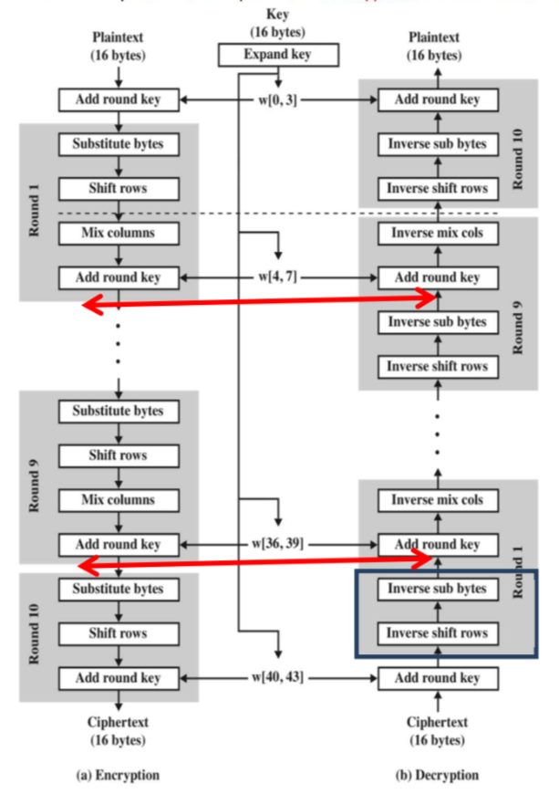
AES
AES (Advanced Encryption Standard) is a widely used symmetric encryption algorithm, chosen for its security and efficiency.
It operates on fixed-size blocks of data and supports key lengths of 128, 192, or 256 bits.
Specifications of our implementation:
Plaint Text Size: 128 bits or 16 bytes
Number of Rounds: 10 rounds
Key Size: 128 bits or 16 bytes

Slide 3
Implementation
Our implementation contains 2 files table.py and aes_implementation.py
table.py contains important tables/boxes including r_con (round_constants) table provides round constant values used in key expansion, while s_box (substitution box) and inv_s_box represent the substitution boxes for forward and inverse substitutions.
aes_implementation.py contains the main code which is divided into several functions.

Slide 4
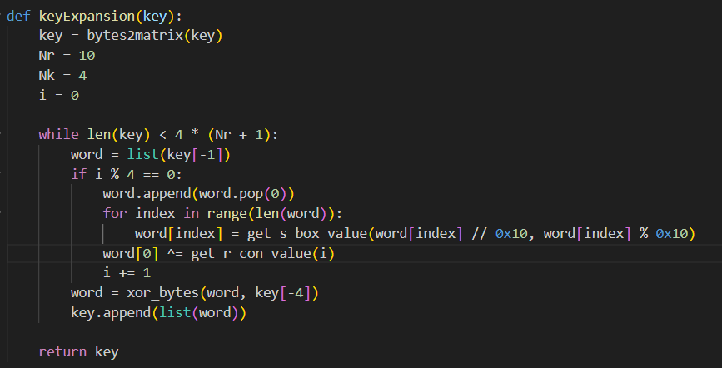
Key Expansion
The Key Expansion process involves transforming a short key into an expanded key schedule.
We generate multiple subkeys (depending on number of rounds) from the expanded key.
AES encryption requires a unique key for each round.
Key expansion involves rotation, substitution, and XOR operations. The round constant values are provided by the R_con table. The S-box (s_box) is applied for byte substitution.

Slide 5
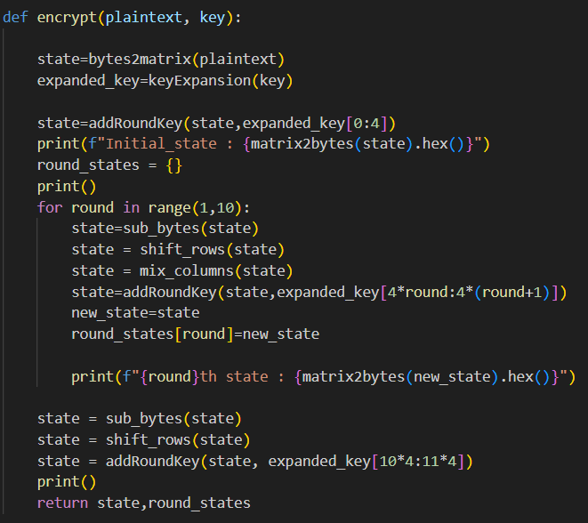
Encryption
In the AES encryption process, the plaintext transforms into ciphertext through rounds.
The encrypt function involves SubBytes (substituting bytes using an S-box), ShiftRows (shifting rows of the state matrix), MixColumns (column-wise mixing), and AddRoundKey (XORing the state with a round key).
Each of these steps are implemented as separate functions in our code.

Slide 6
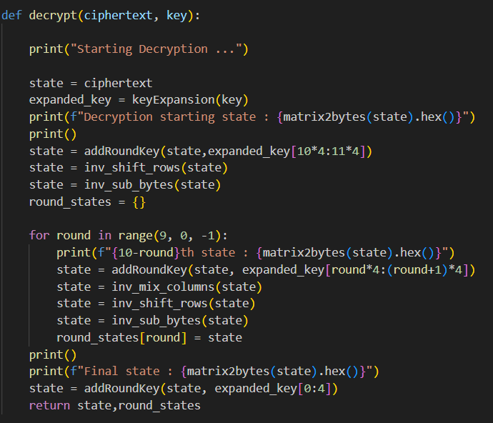
Decryption
Decryption reverses encryption through the decrypt function, applying inverse operations: InvShiftRows, InvSubBytes, InvMixColumns, and AddRoundKey. This process ensures accurate reconstruction of the original plaintext.
Each of these steps are implemented as separate functions in our code.

Slide 7

Thanks!
Krishna Somani 2021058
Mayank Gupta 2021065

